Slide 2
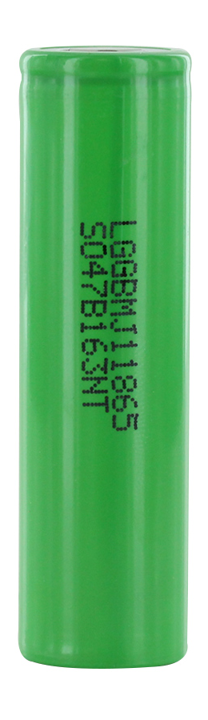
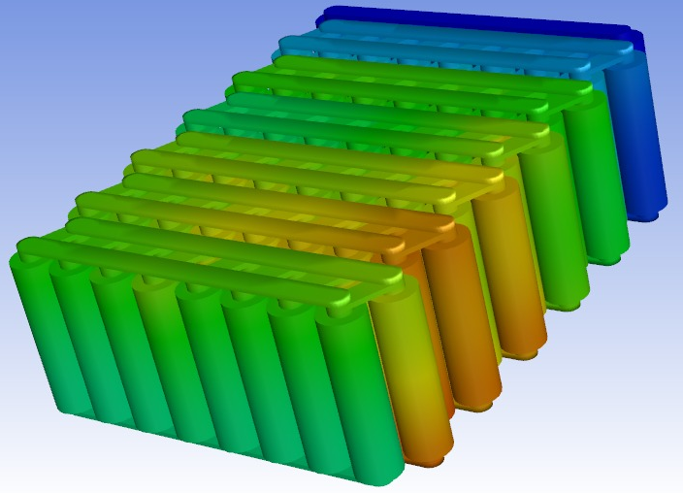
HIGH VOLTAGE – Battery 13S16P
Twin 48V 28Ah Battery Pack connected in parallel.
160A max Discharge rating.
Li-ion 3500mAh LG INR18650 MJ-1 cells.
NMC 160A max Discharge.
Staggered arrangement of cells.
Reduction in max temperature difference.
BMS for each 28Ah module.

Slide 3
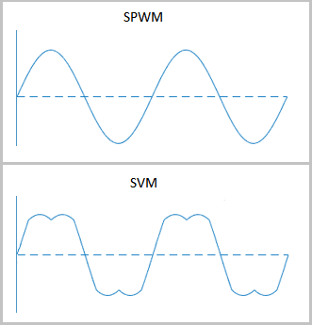
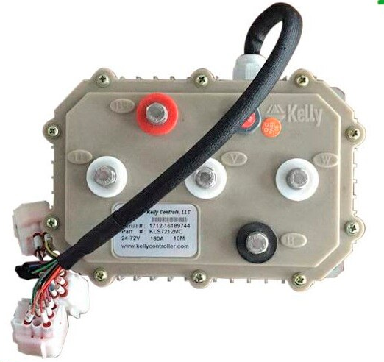
HIGH VOLTAGE- Motor and SMPS
2kW rated BLDC Motor.
Max 3kW power.
41A rated current.
SV-PWM Motor controller.
SV-PWM is 15% more efficient than Sine-pwm.
48-12V SMPS DC-DC Converter.

Slide 4
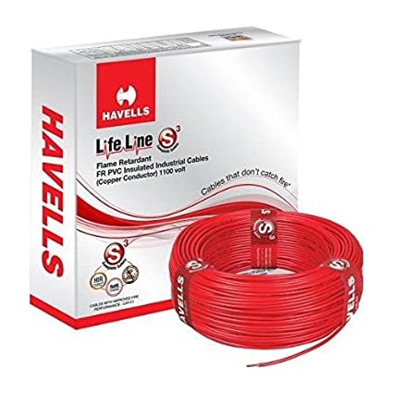
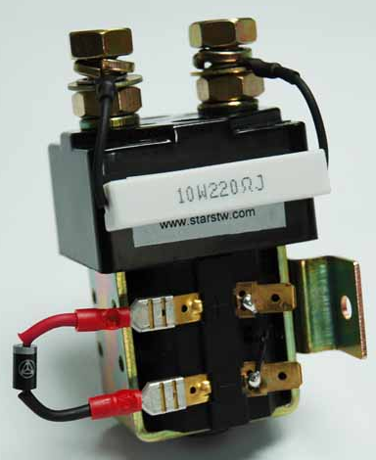
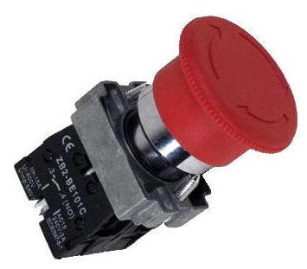
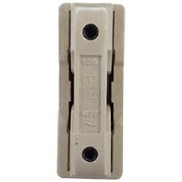
HIGH VOLTAGE - Safety
Contactor for Load current.
Pre-charge resistor for arc protection.
2.5 sq.mm wire for power wires.
Fuse attached to B+ wire.
Kill switch shuts down motor.

